Slide 1
1 meter of elevation head
1 meter
Reference elevation
1 meter of pressure head
1 meter of velocity head

Slide 2
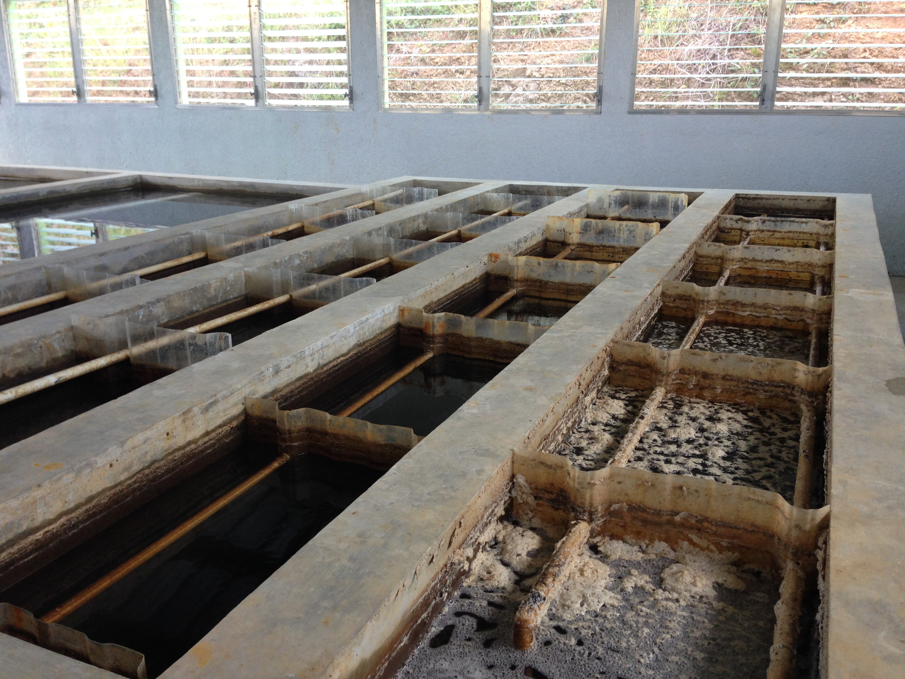
AguaClara Flocculator
Top Baffles
Bottom Baffles, underwater

Slide 3
AguaClara Flocculator

Slide 4
AguaClara Flocculator
Top and Bottom Baffles
Top Baffles
Bottom Baffles, underwater
Flocculator Channels
Flow Path

Slide 6
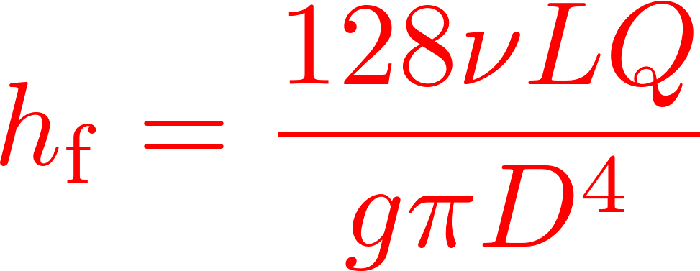
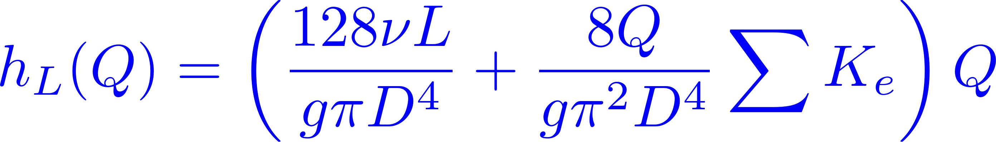

Calibrate at max flow

Slide 7
Baffles
Baffle

Slide 8
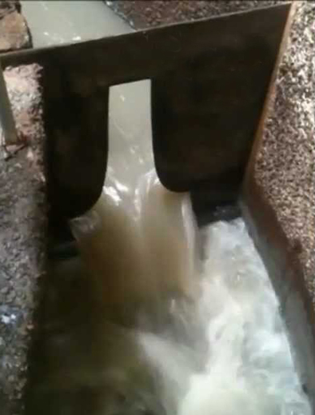
Sutro Weir
LFOM

Slide 9

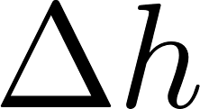


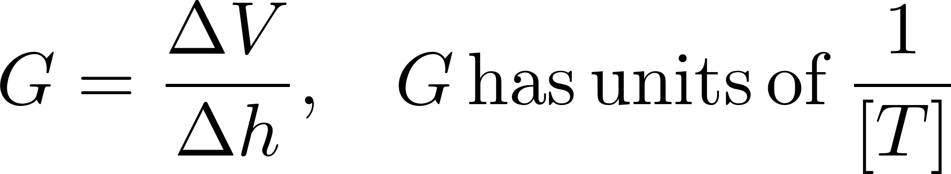

Slide 10

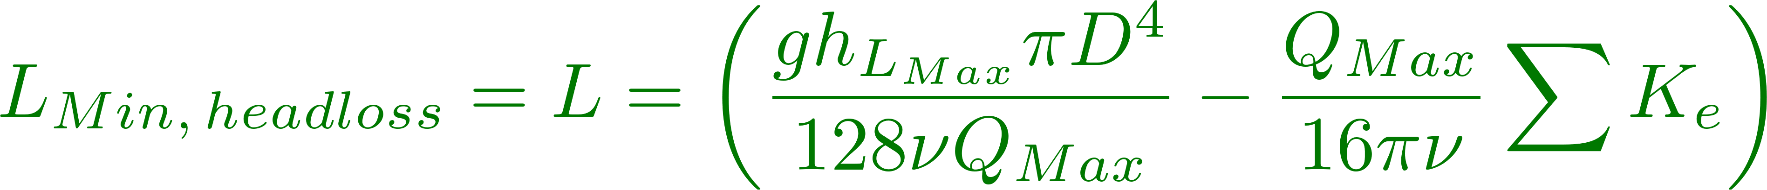

Slide 11
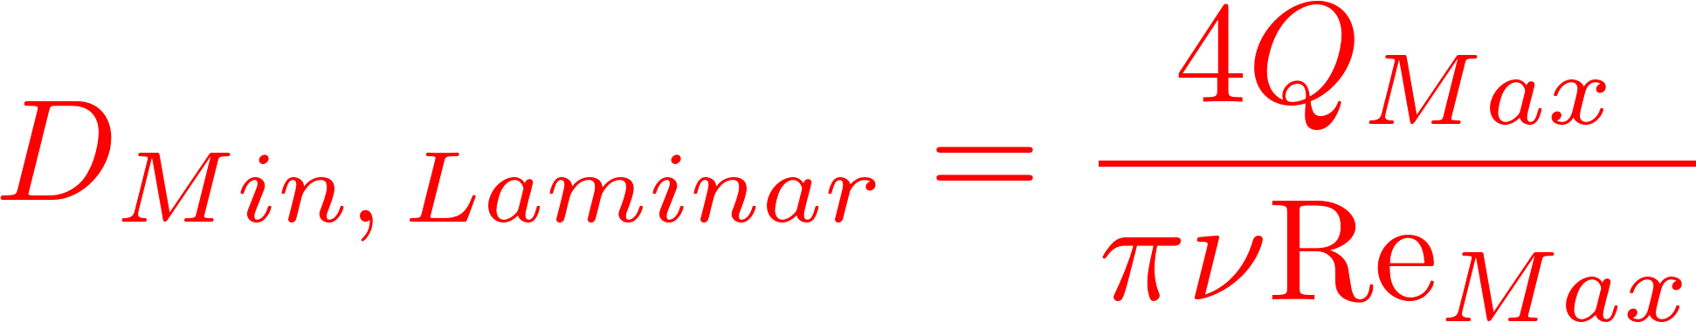
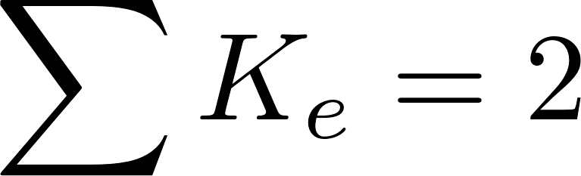
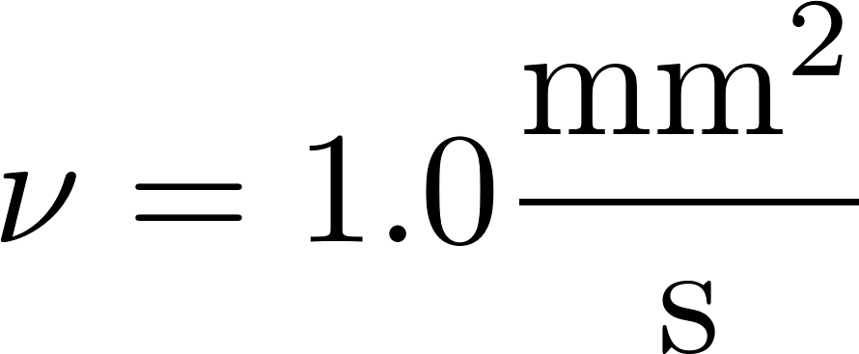
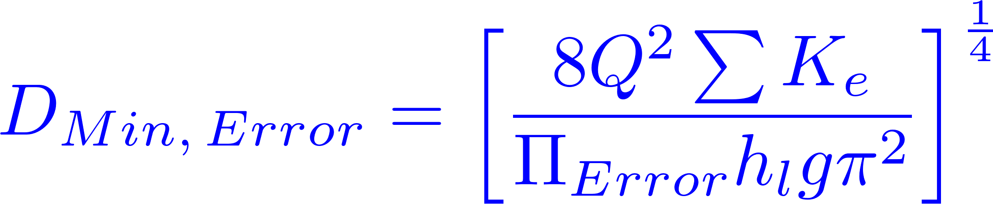
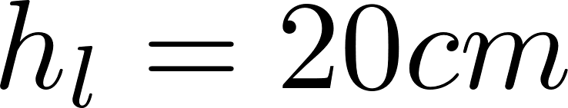
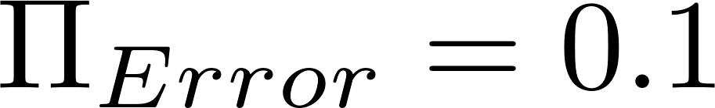

Slide 12
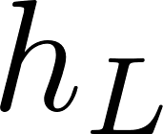
Small diameter tubing

Slide 13
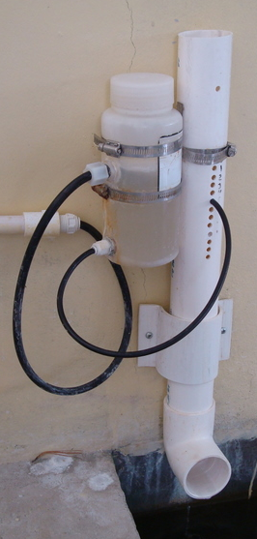
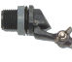
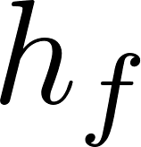
Air vent
Tube from the stock tank
Float valve
Holes to choose the dose
Flexible tube
Raw water
Rapid Mix
Orifice

Slide 14
V_{in}
V_{out}
A_{in}
x
A_{out}
in
out

Slide 15
Horizontal orifice
Vertical orifice

Slide 16
Overhead Tank
Constant head orifice
Overflow pipe
Pump

Slide 17


A
B

Slide 18
Pipe stub
Pipe coupling
Drain piping

Slide 19
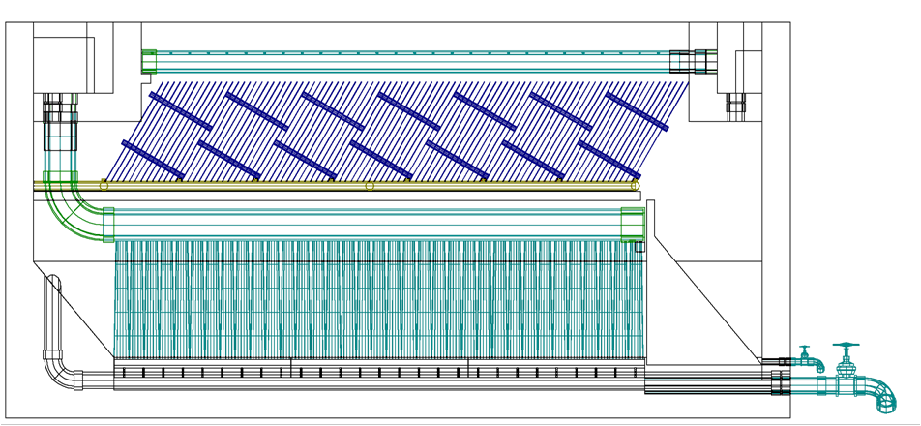
AutoCAD drawing of sedimentation tank, don’t worry if this is confusing!
You’ll learn about it in depth later on.
Sedimentation
tank drain

Slide 20


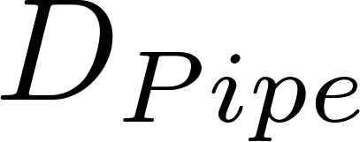
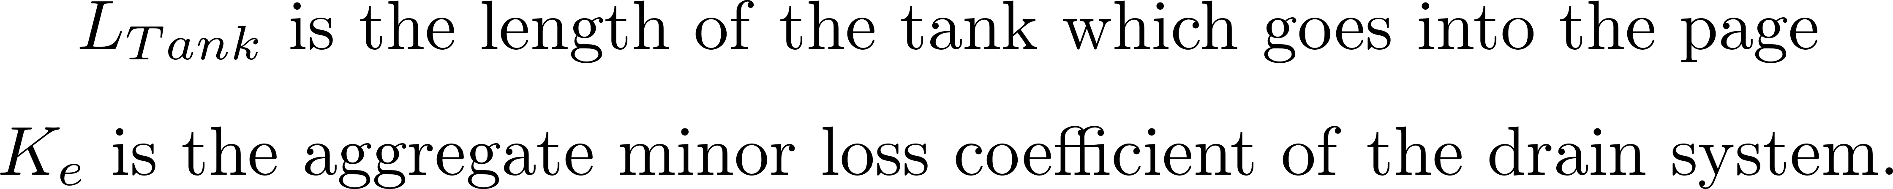

Slide 21

Float
Float
Orifice
Orifice
Transparent flexible tube
Transparent flexible tube

Slide 23
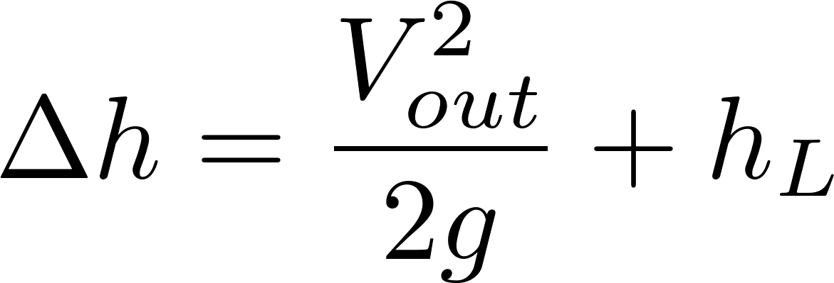
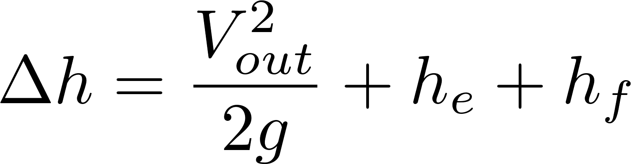
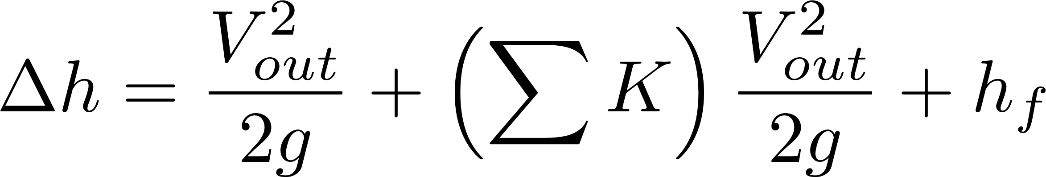
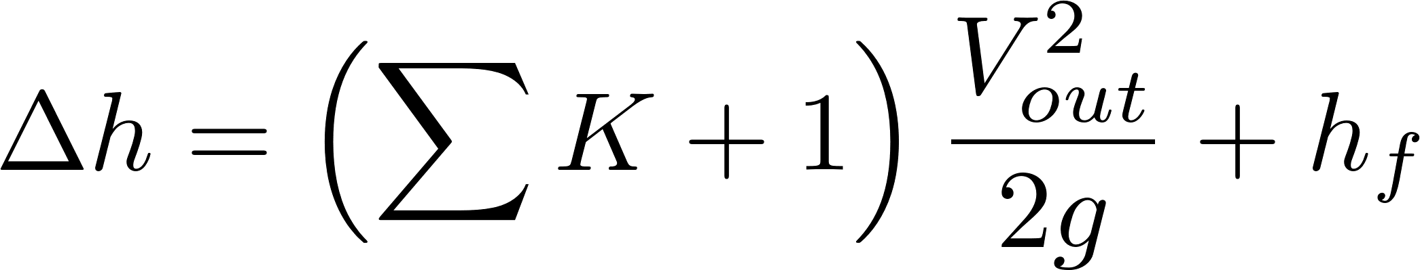
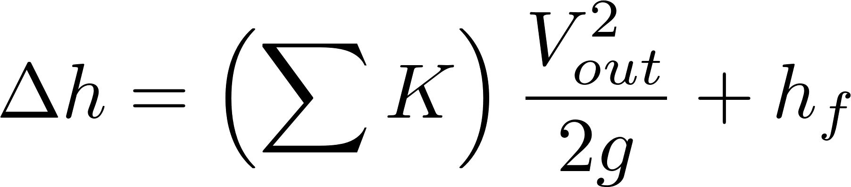
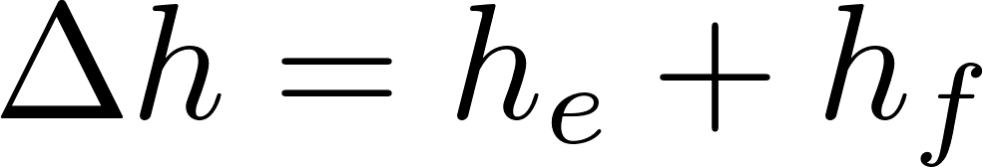

Simplified
energy equation
Just adding
K = 1 to the sum

Slide 24
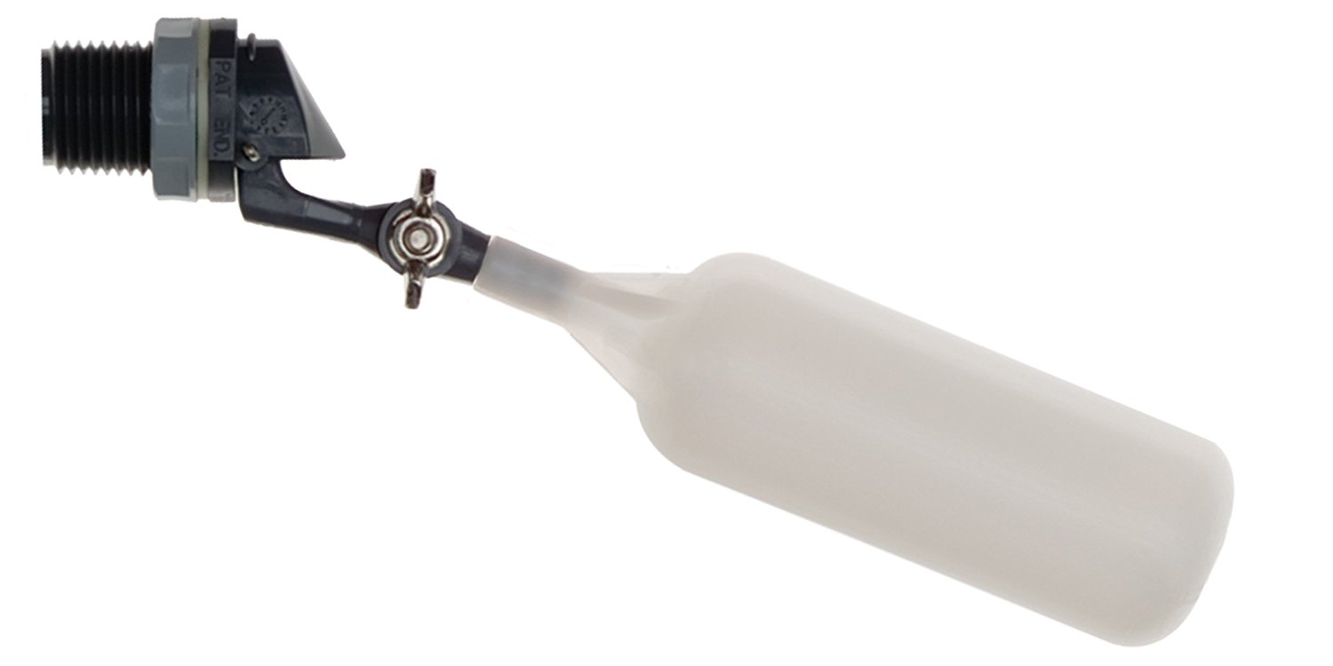
Flow of water
out of valve
Range of
motion of float
Float

Slide 25
C
B
A

Slide 26
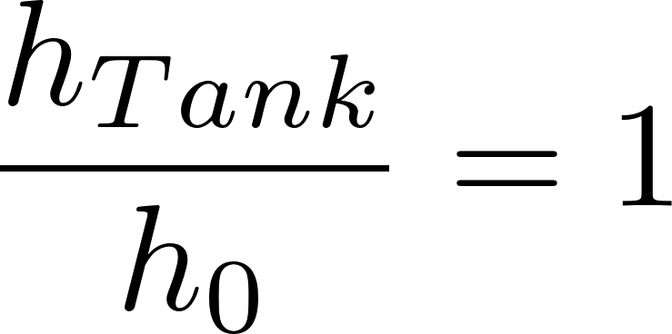
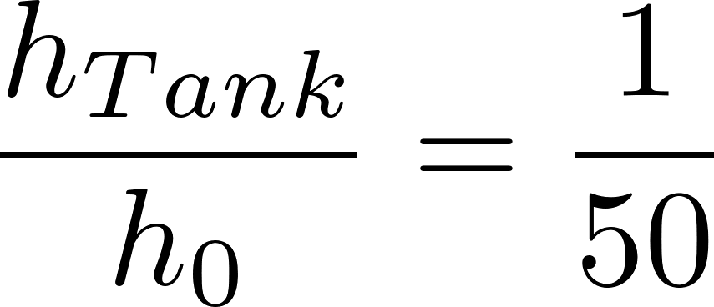
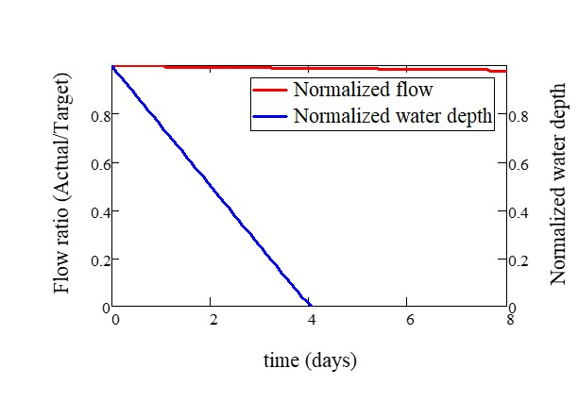
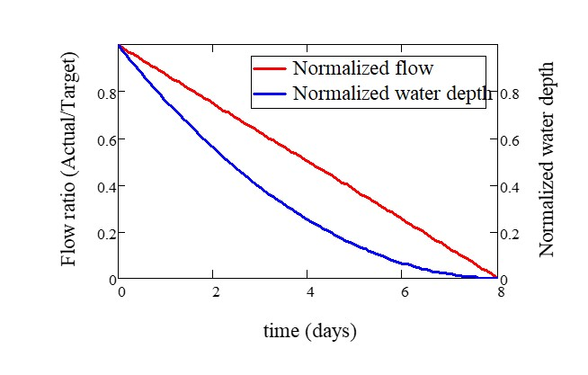

Slide 27

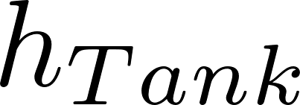
Tank
Valve
Water source pipe
Tank
Valve
Water source pipe

